Slide 1
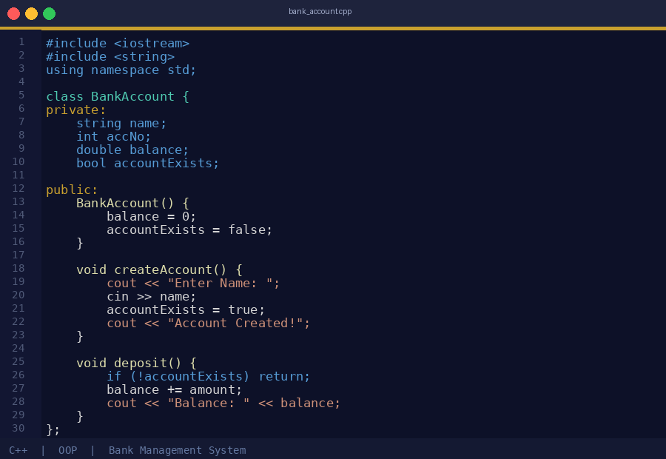
BANK
MANAGEMENT
SYSTEM
Presented by:
CH. NAGA HASINI – AP25110070302
N. VYSHNAVI SAI – AP25110070855
C++ • OOP • Console Application

Slide 2
AIM OF THE PROJECT
What we set out to build
1
2
3
4
Develop a Bank Management System using C++
Simulate real-world banking operations in a console environment
Implement account creation and transaction handling
Ensure proper validation before performing any operation

Slide 3
INTRODUCTION
Overview of the system
Key Highlights
Technology
▸ Manages basic banking operations through a structured menu
▸ Console-based and user-friendly application
▸ Supports account creation, deposits, withdrawals, and balance checks
▸ Developed using Object-Oriented Programming principles in C++
C++ with OOP
Object-Oriented Design
Features
✓ Account Creation
✓ Deposit & Withdrawal
✓ Balance Enquiry
✓ Input Validation

Slide 4
ABSTRACT
"A console-based application designed to simulate real-world banking operations. The system allows users to create a bank account and perform essential transactions such as deposits and withdrawals. Operations are restricted until an account is created, demonstrating logical validation and real-world banking flow."
Console App
Transactions
Validation
OOP Design
Simulates banking via text-based menu interface
Deposit, withdrawal & balance check supported
Prevents ops without account creation first
Real-world logic via encapsulation in C++

Slide 5
REQUIREMENTS
Software & Hardware
💻 Software
🖥️ Hardware
▸ C++ Compiler
▸ Turbo C++ / Code::Blocks / VS Code
▸ Operating System: Windows / Linux
▸ Standard C++ Libraries (iostream, string)
▸ Minimum 4 GB RAM
▸ Processor: Intel Core i3 or above
▸ Storage: 100 MB free space
▸ Display: Any standard monitor

Slide 6
METHODOLOGY
Step-by-step operational flow
1
2
3
4
5
Display Menu
User Selection
Account Check
Execute Operation
Show Result
▶
▶
▶
▶
Show all available banking options to the user
User picks the desired operation from the menu
Verify whether a bank account has been created
Perform the selected banking transaction
Display the outcome or updated balance to the user

Slide 7
WORKFLOW DIAGRAM
START
Display Menu
User Makes a Choice
Is Account Created?
No → Show: 'Please create account first'
Perform Operation
Display Output
EXIT

Slide 8
CODE – BankAccount Class
#include <iostream>
#include <string>
using namespace std;
class BankAccount {
private:
string name;
int accNo;
double balance;
bool accountExists;
public:
BankAccount() {
balance = 0;
accountExists = false;
}
void createAccount() {
cout << "Enter Account Holder Name: ";
cin >> name;
cout << "Enter Account Number: ";
cin >> accNo;
cout << "Enter Initial Balance: ";
cin >> balance;
accountExists = true;
cout << "Account Created Successfully!" << endl;
}
void deposit() {
if (!accountExists) {
cout << "No account! Create one first." << endl;
return;
}
double amount;
cout << "Enter amount to deposit: ";
cin >> amount;
balance += amount;
cout << "Deposit Successful! Balance: " << balance;
}
void withdraw() {
if (!accountExists) { return; }
double amount;
cin >> amount;
if (amount > balance) {
cout << "Insufficient Balance!" << endl;
} else {
balance -= amount;
cout << "Remaining Balance: " << balance;
}
}
void checkBalance() {
if (!accountExists) { return; }
cout << "Current Balance: " << balance << endl;
}
};

Slide 9
CODE – Main Function
int main() {
BankAccount acc;
int choice;
do {
cout << "\n===== BANK MANAGEMENT SYSTEM =====" << endl;
cout << "1. Create Account" << endl;
cout << "2. Deposit" << endl;
cout << "3. Withdraw" << endl;
cout << "4. Check Balance" << endl;
cout << "5. Exit" << endl;
cout << "Enter your choice: ";
cin >> choice;
switch(choice) {
case 1: acc.createAccount(); break;
case 2: acc.deposit(); break;
case 3: acc.withdraw(); break;
case 4: acc.checkBalance(); break;
case 5: cout << "Thank you!" << endl; break;
default: cout << "Invalid choice!" << endl;
}
} while(choice != 5);
return 0;
}
Key Points
▸ BankAccount object created in main
▸ do-while loop keeps menu active
▸ switch-case routes each choice
▸ Loop exits when user selects 5
▸ Encapsulation: all logic inside class
▸ Simple, readable structure

Slide 10
PROGRAM OUTPUT
Console screenshots from execution
⚠ Without Account
✅ Create, Deposit & Withdraw
💰 Balance Check & Exit
===== BANK MANAGEMENT SYSTEM =====
1. Create Account
2. Deposit
3. Withdraw
4. Check Balance
5. Exit
Enter your choice: 2
No account available!
Please create an account
first.
Enter your choice: 1
Enter Account Holder Name: Ramya
Enter Account Number: 10234
Enter Initial Balance: 1000
Account Created Successfully!
Enter your choice: 2
Enter amount to deposit: 500
Deposit Successful!
Current Balance: 1500
Enter your choice: 3
Enter amount to withdraw: 200
Withdrawal Successful!
Remaining Balance: 1300
Enter your choice: 4
Current Balance: 1300
Enter your choice: 5
Thank you!
[Program Exits]

Slide 11
CONCLUSION
✔
Implemented all core banking operations successfully using C++
✔
Demonstrated OOP concepts: encapsulation, classes, and methods
✔
Added account existence validation before every operation
✔
Ensures a logical, user-friendly flow of operations
The project successfully demonstrates a working Bank Management System using core C++ and OOP principles.

Slide 12
FUTURE ENHANCEMENTS
Roadmap for next version
🔐
PIN Authentication
💾
File Handling
🖥
GUI Interface
Add secure 4-digit PIN login for account protection and user identity verification
Persist account data across sessions using file I/O so records are not lost on exit
Develop a graphical user interface using Qt or similar frameworks for better UX
👥
Multi-User System
📊
Transaction History
🌐
Network Support
Support multiple accounts simultaneously with unique account numbers and profiles
Log and display full transaction history with timestamps for each account
Extend to a client-server model enabling remote banking via network

Slide 13
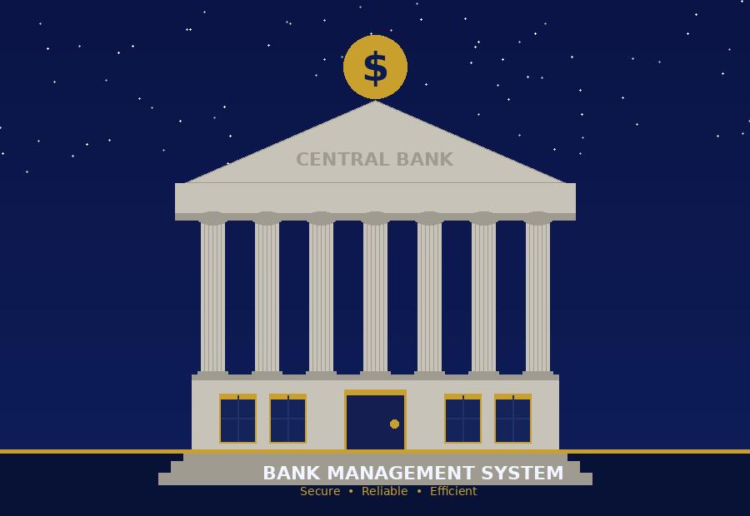
THANK
YOU!
Bank Management System | C++ OOP Project
CH. NAGA HASINI & N. VYSHNAVI SAI
AP25110070302 & AP25110070855

